Slide 1

The Security Guide to the Internet
Author: Bc. David Nápravník
Supervisor: doc. Mgr. Cyril Brom, Ph.D.
Let’s play and learn
2025

Slide 2
Motivation
95%
26%
The growing threat landscape for children online
Need for interactive, engaging cybersecurity education
kids are using mobile phone with internet access daily in age of 12 in Czech Republic
of children (11-15 y.o.) report
encountering phishing attack
Source: eu_kids_online_report
Source: Overconfident and over exposed

Slide 3
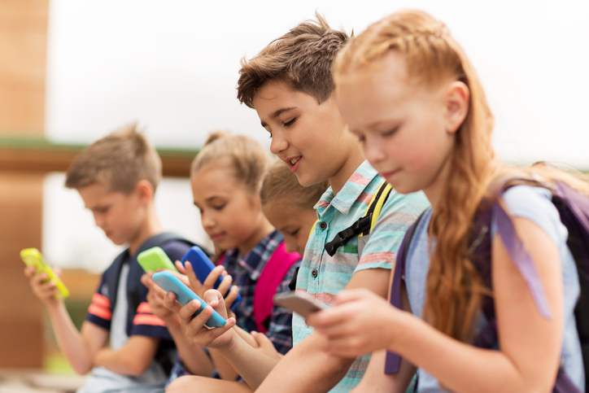
Target Audience
Middle school students.
Single player at home, or at school.
Czech or English speaking.
Years 11-15
Kids doesn’t have much security awareness and they are often exposed to cyber danger
Image from freedomfone.org

Slide 4
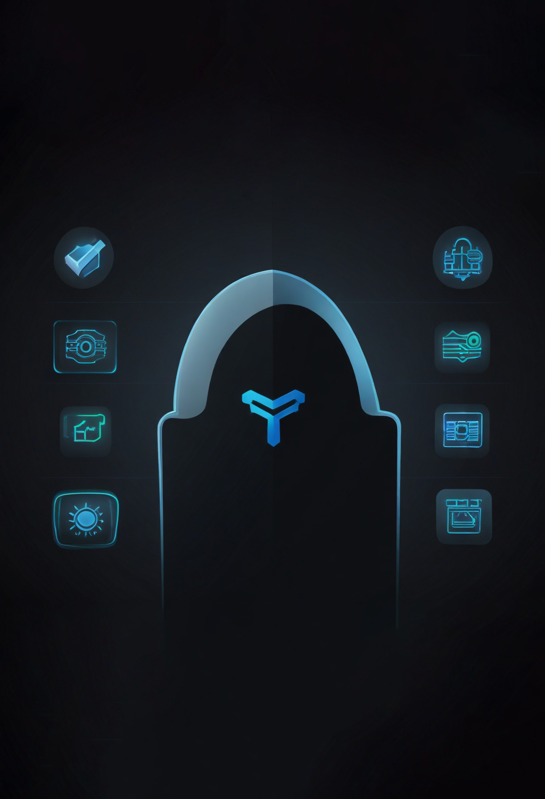
Security thread topics
Malware: Virus, Antivirus, Firewall, Software updates, Data backup
File extensions, Game with virus, Fake free stuff
Antivirus is a good thing, but it doesn't do everything
Privacy: Phishing, Identity theft, Social engineering
Digital footprint, Privacy protection, Bad practices
Cookies & GDPR
Phone: App Permissions
Bluetooth and wi-fi safe usage
Access: Strong passwords, Password managers, Two-factor Authentication
AI: Information quality, private data sharing

Slide 5

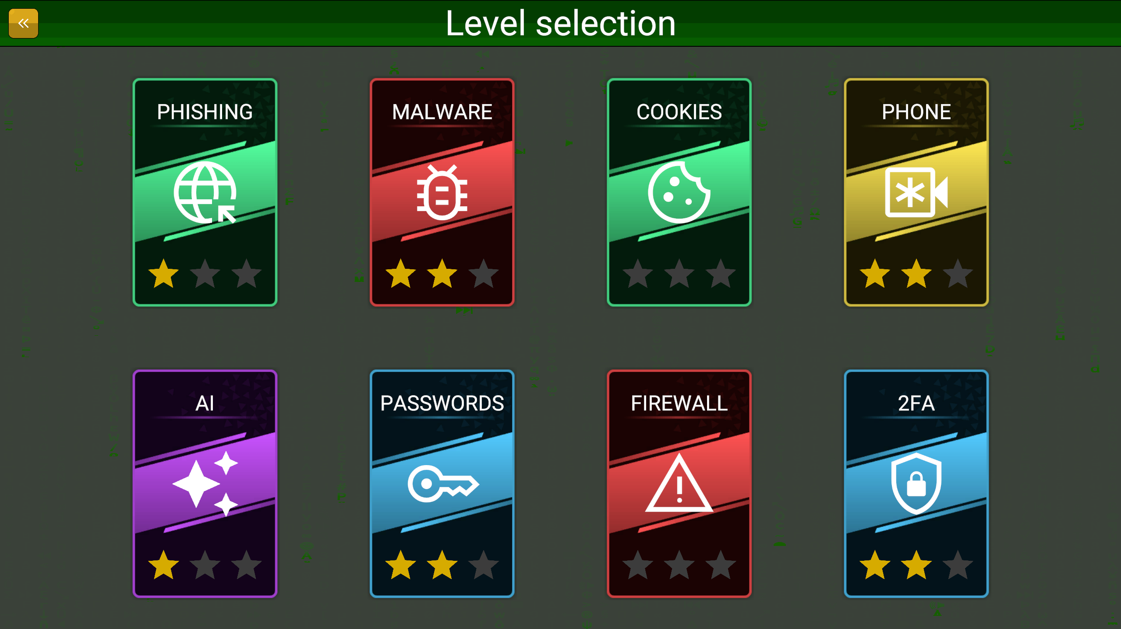

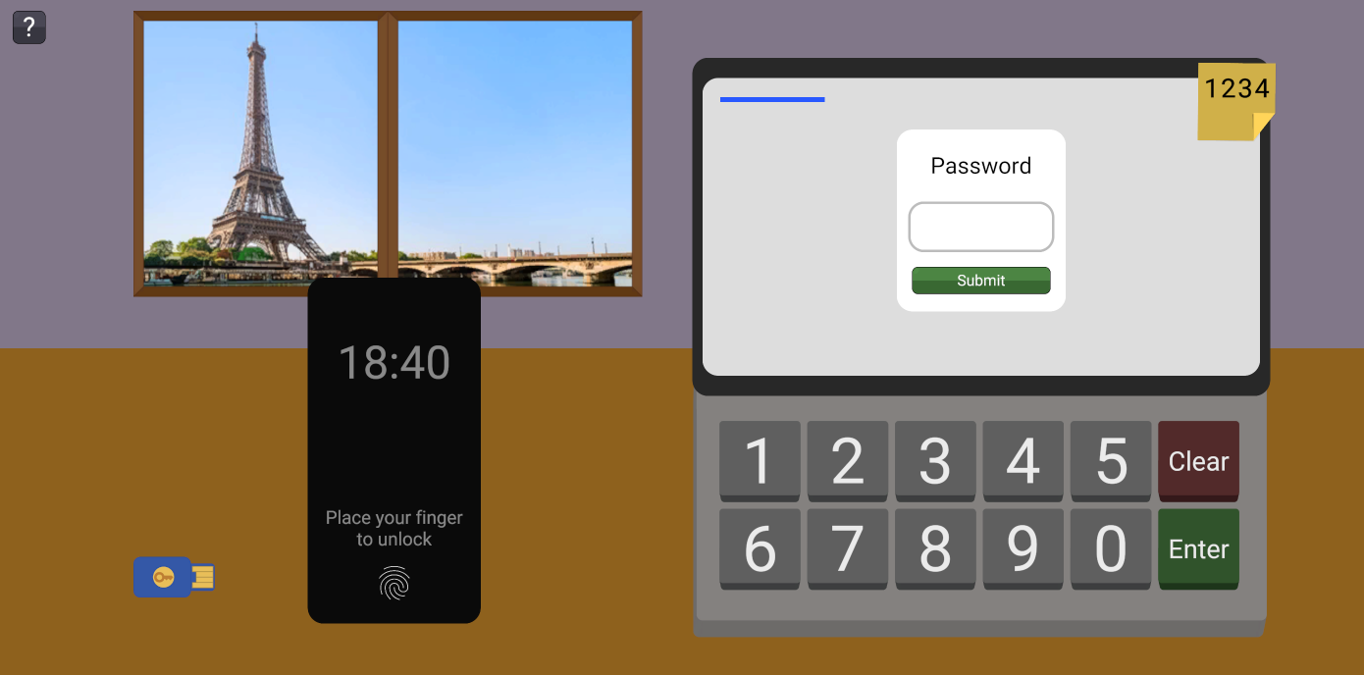
Multiple levels
Each for some group of security topic
Each with unique gameplay mechanic
Multiple devices support
Android, Computer (without installation)
Multiple localizations
Czech, English
Compliances
PEGI 7
Accessibility
Game Concept
Images from the thesis

Slide 6
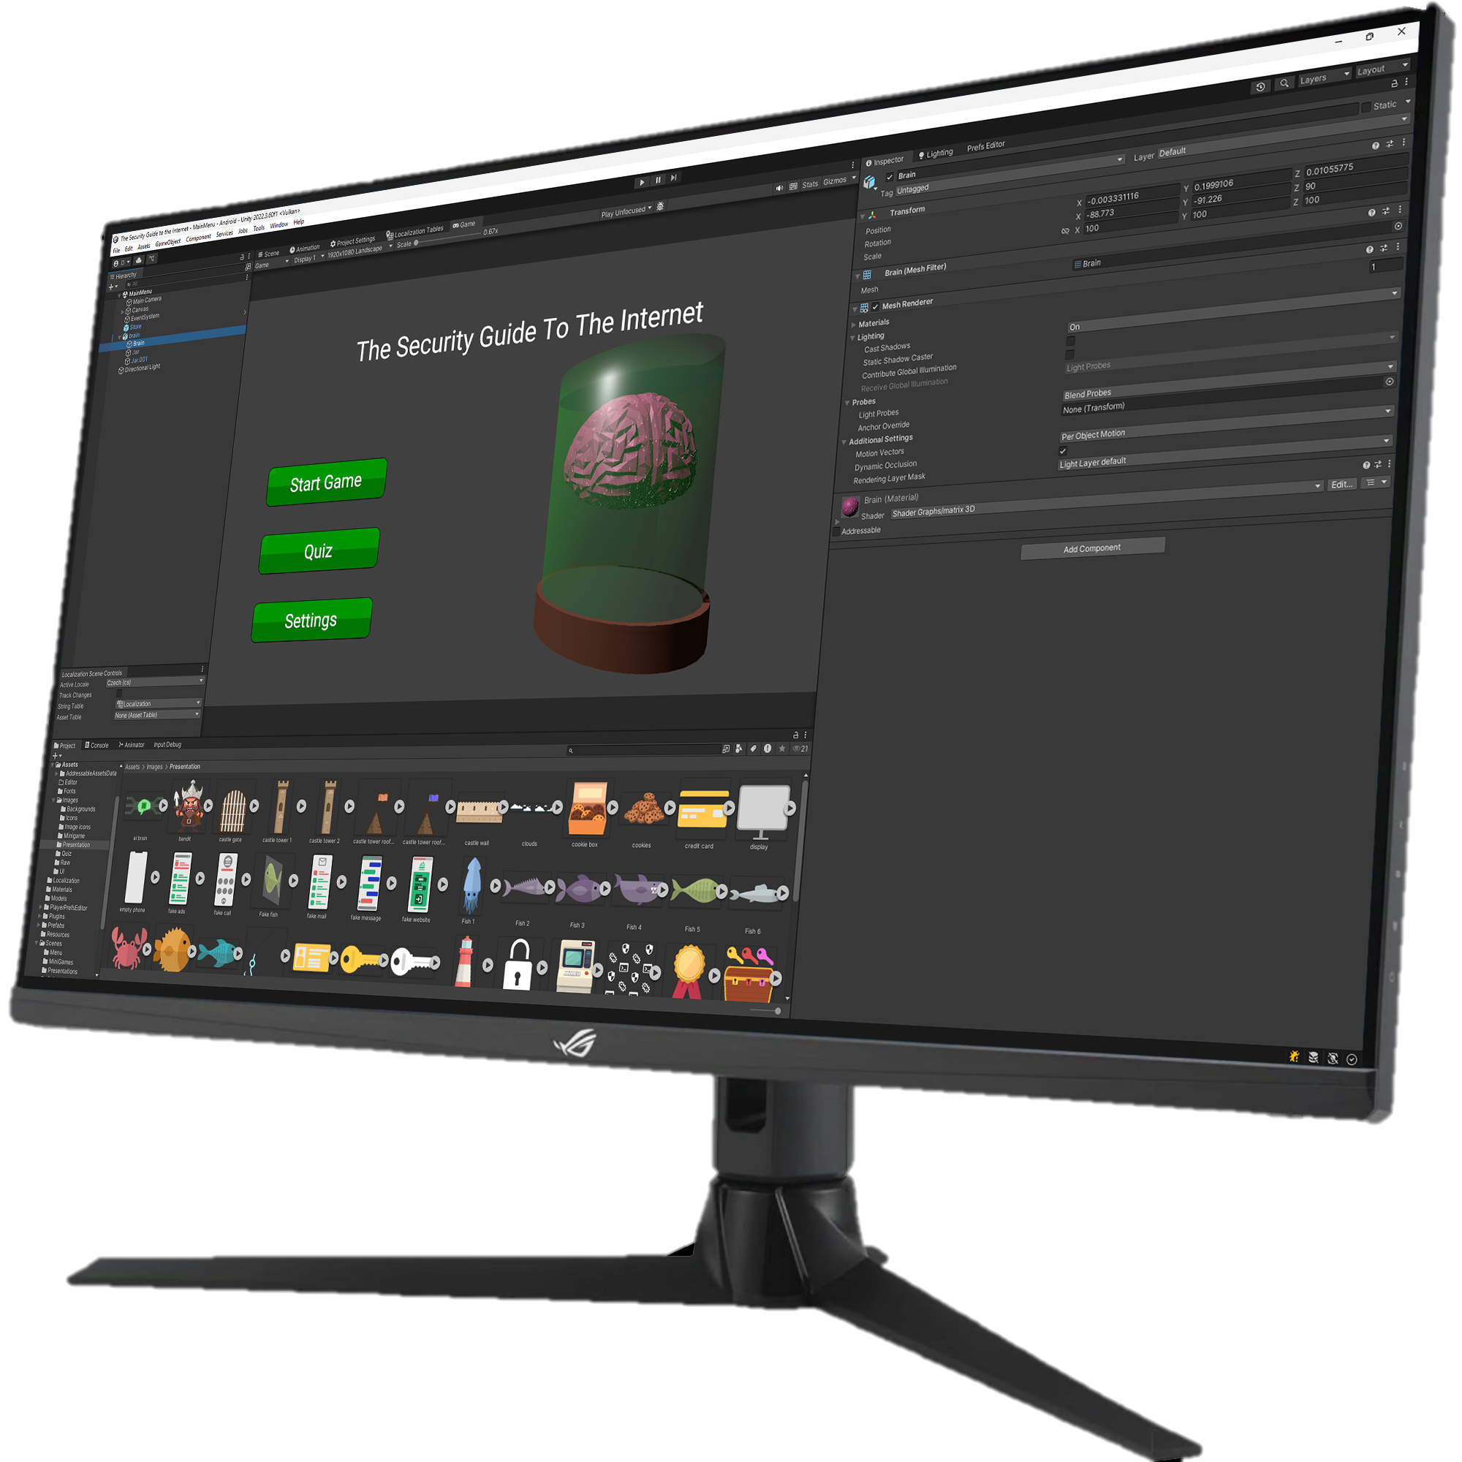


Implementation Details
Game engine
Localization
Text rendering optimizations
Bundle size optimizations
Level-specific mechanic
 | Godot | Unity | Unreal engine
Web build
Low-end devices
Advanced profiling tools
Image of this thesis Unity project

Slide 7


Implementation Details
Unity engine
Localization
Text rendering optimizations
Bundle size optimizations
Level-specific mechanic
Image from the thesis

Slide 8



Implementation Details
Unity engine
Localization
Text rendering optimizations
Bundle size optimizations
Level-specific mechanic
Raster
SDFAA
WCAG 2.0
Contrast ≥ 4.5
Text size ≥ 24 px
AA
SDF32
Images from the thesis

Slide 9
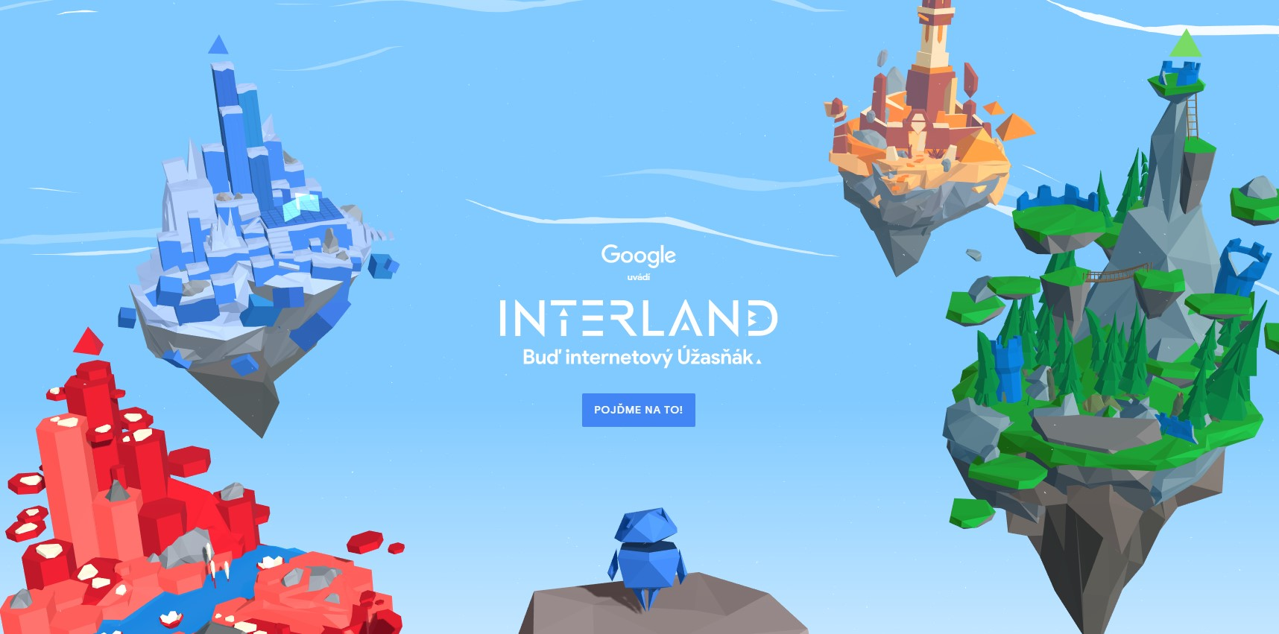

Implementation Details
Unity engine
Localization
Text rendering optimizations
Bundle size optimizations
Level-specific mechanic
Scripts 2%
Shaders 4%
Models 3%
Other 9%
Textures 82%
28.8 MB (4 levels)
Pre-rendered Font atlas 9%
11.2 MB (8 levels)
78.1 MB (2 levels)
Images from beinternetawesome.withgoogle.com & internethighway.e-bezpeci.cz

Slide 10
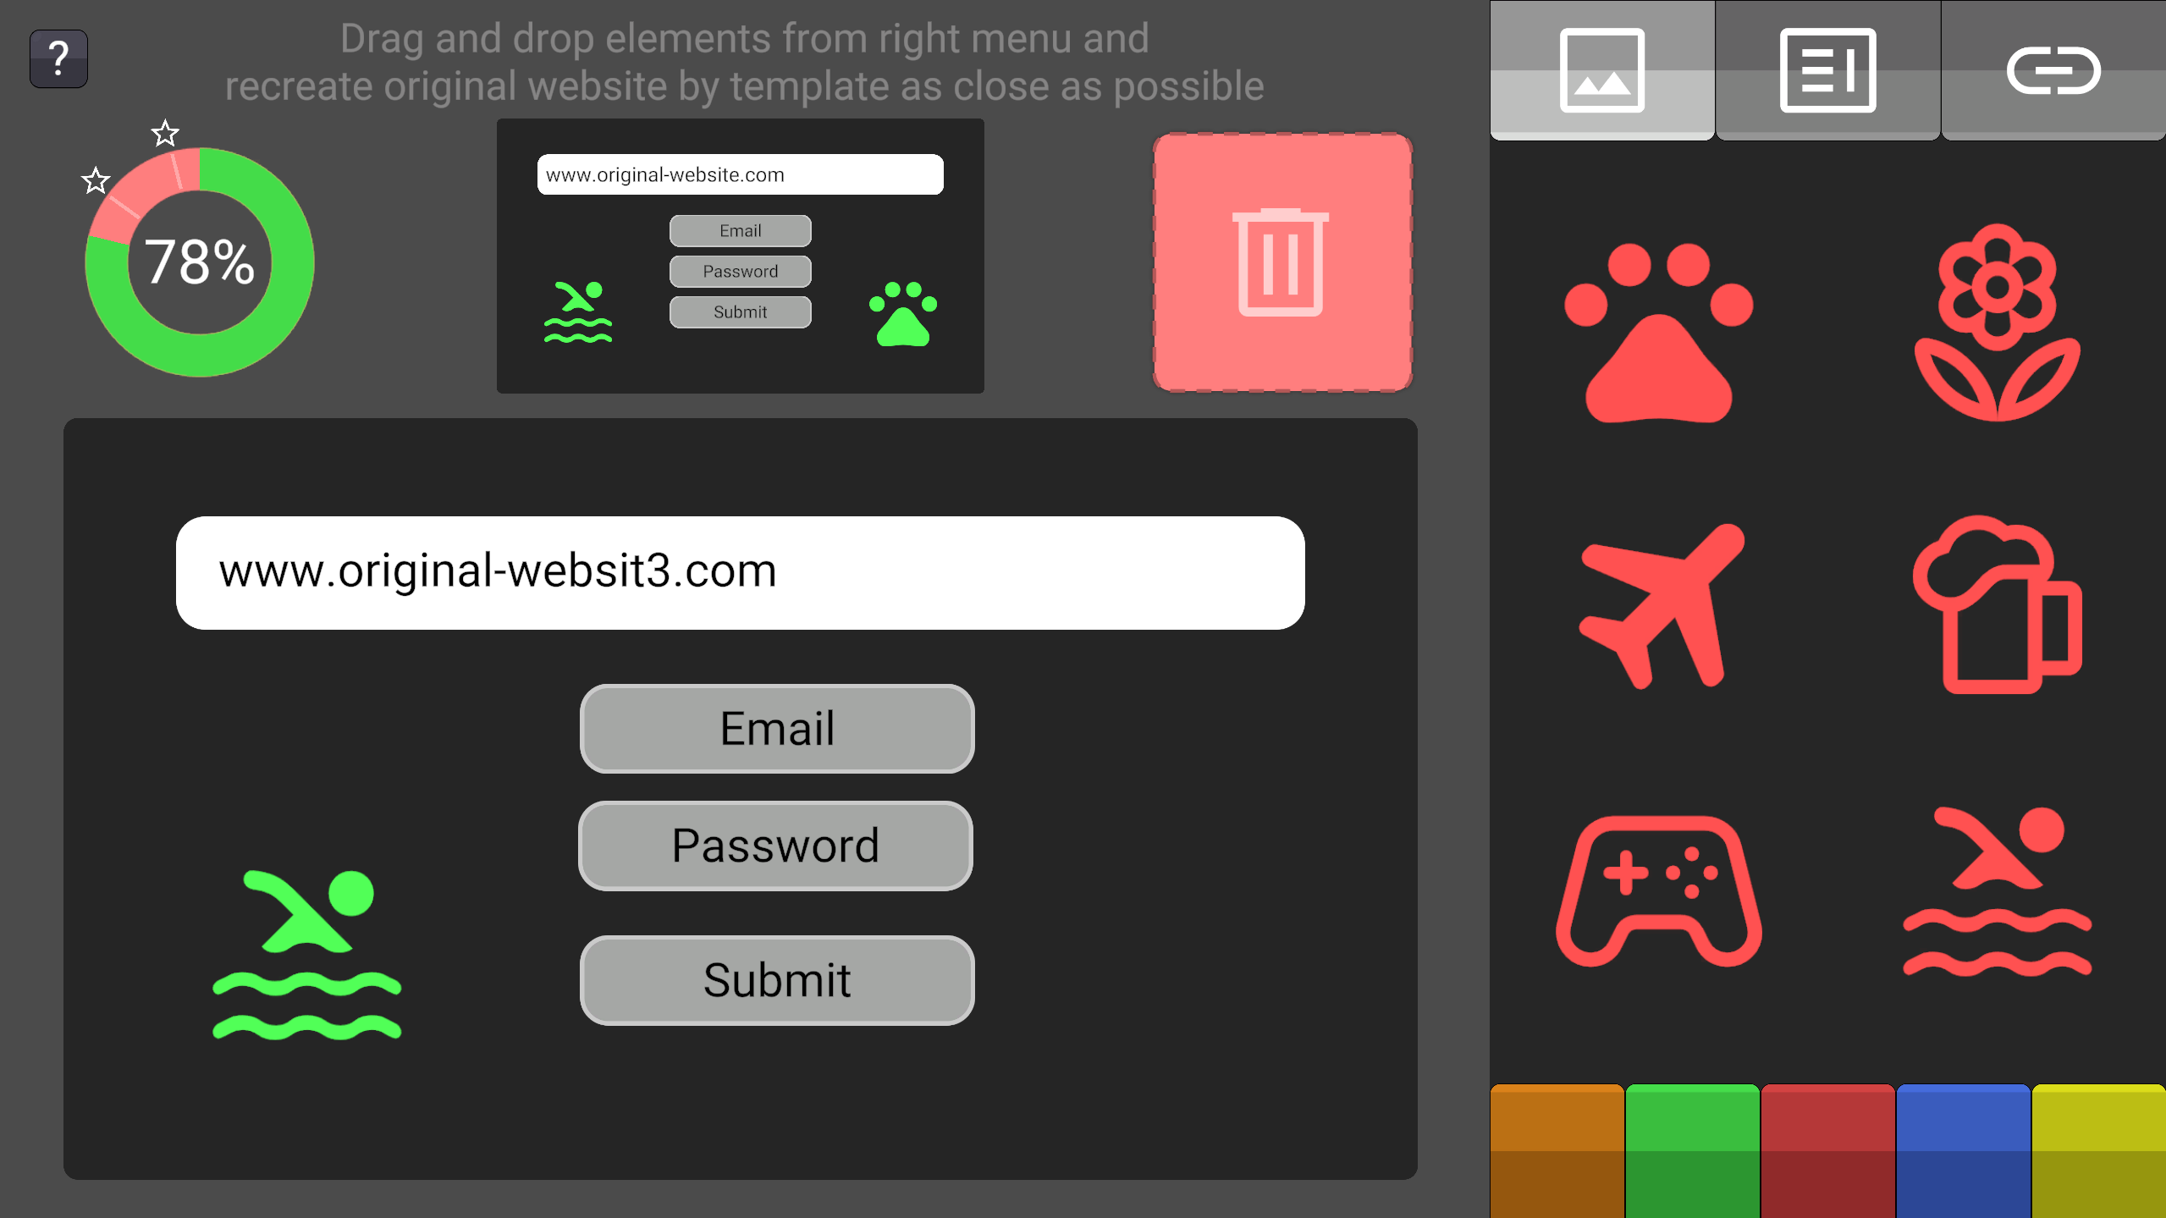
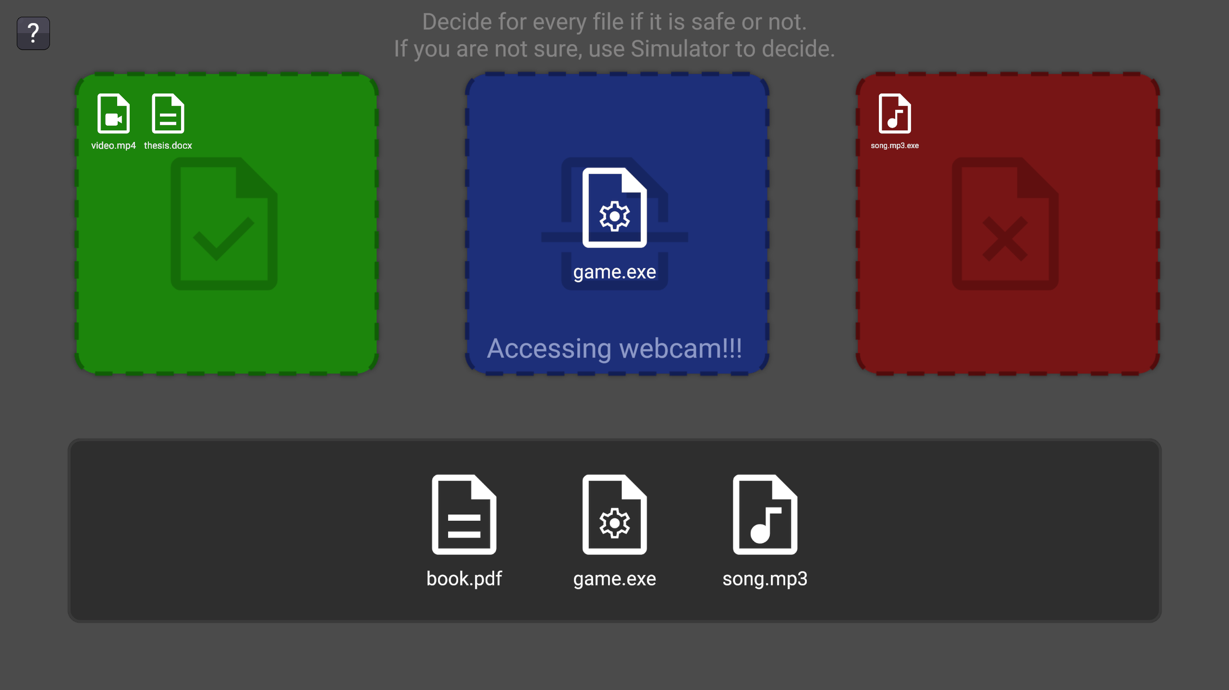
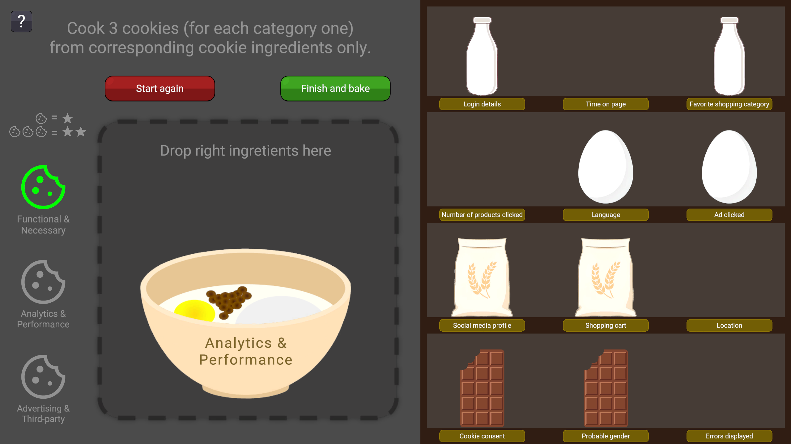
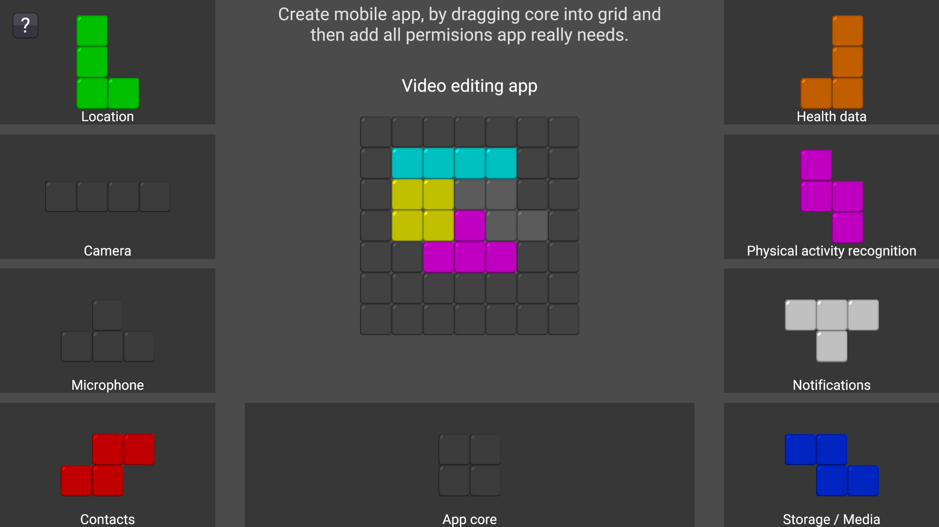
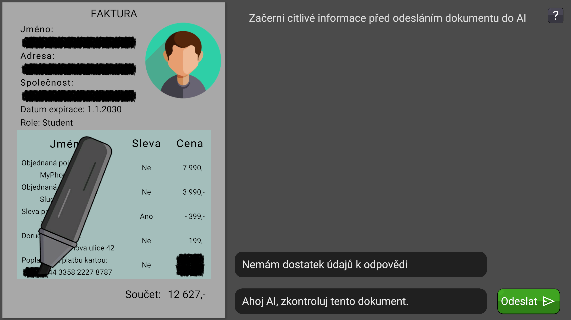
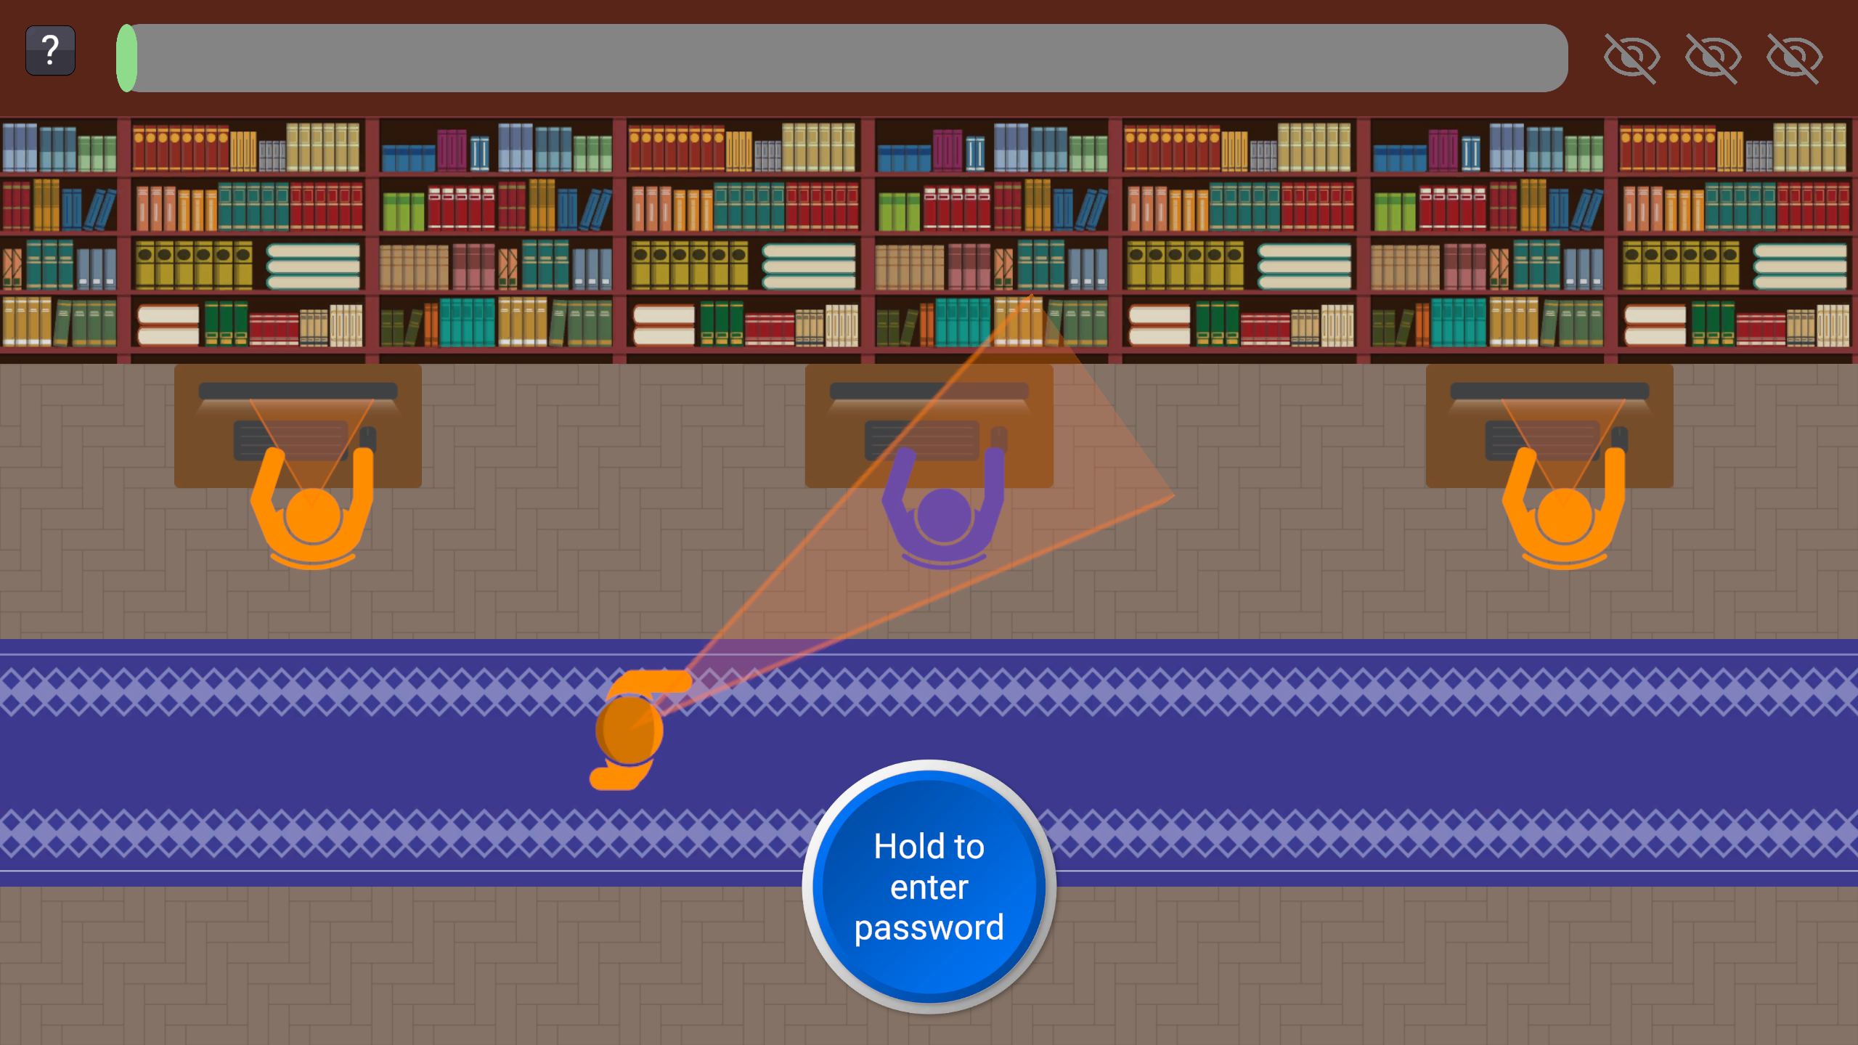
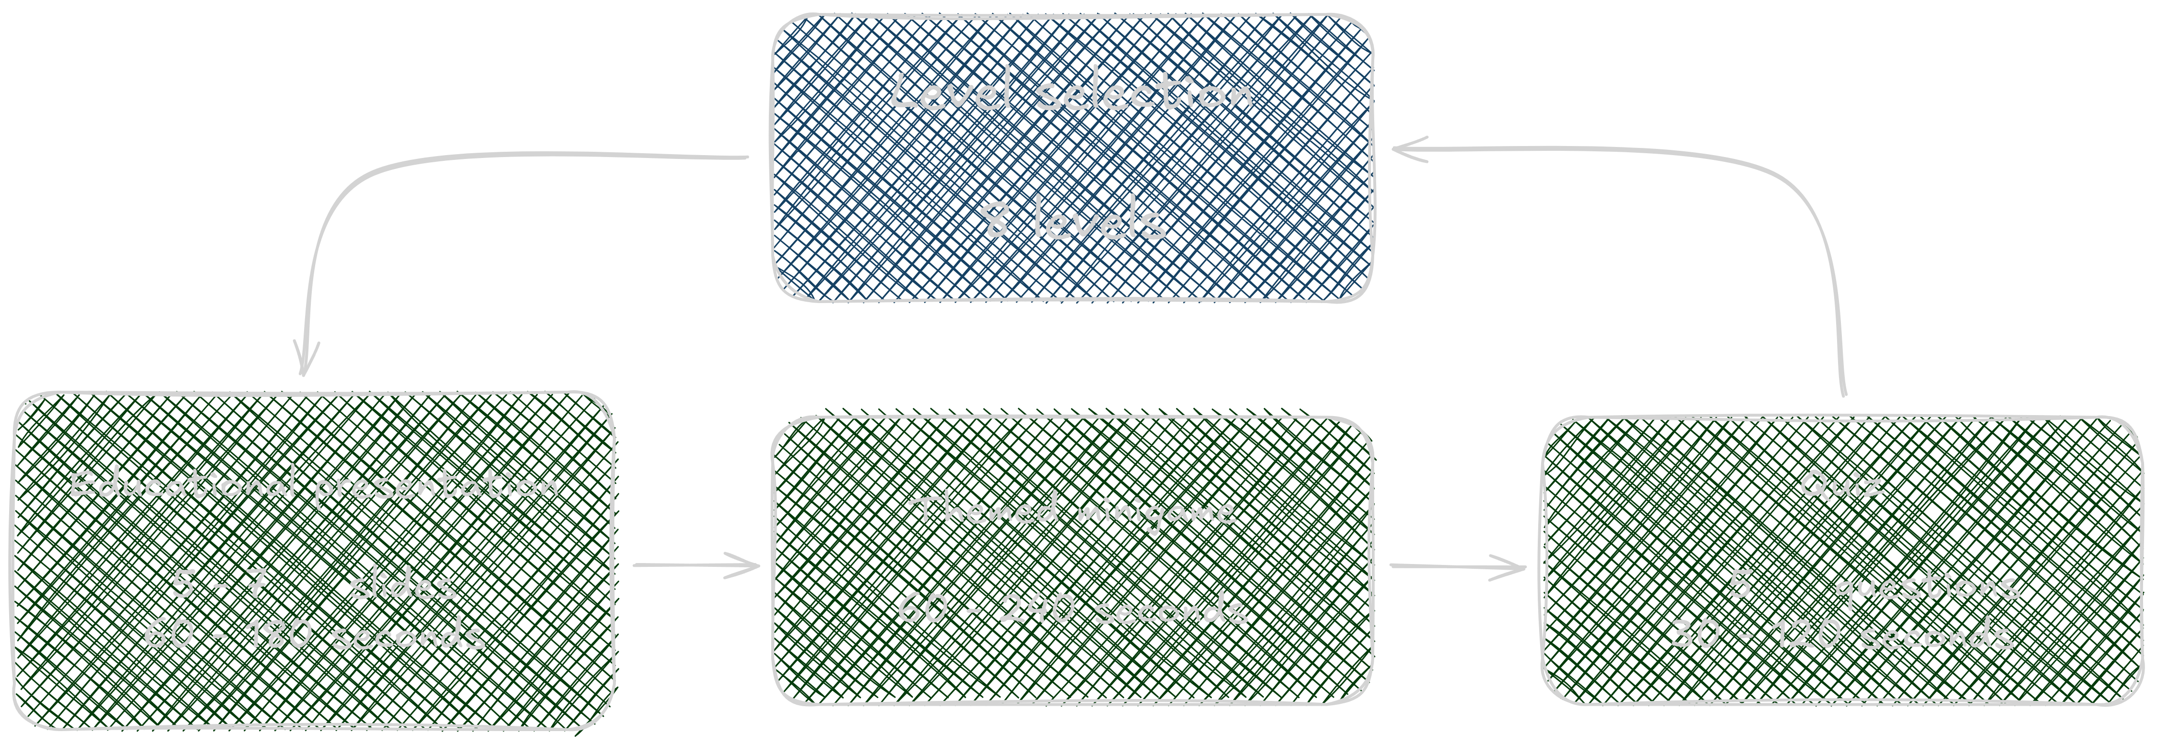
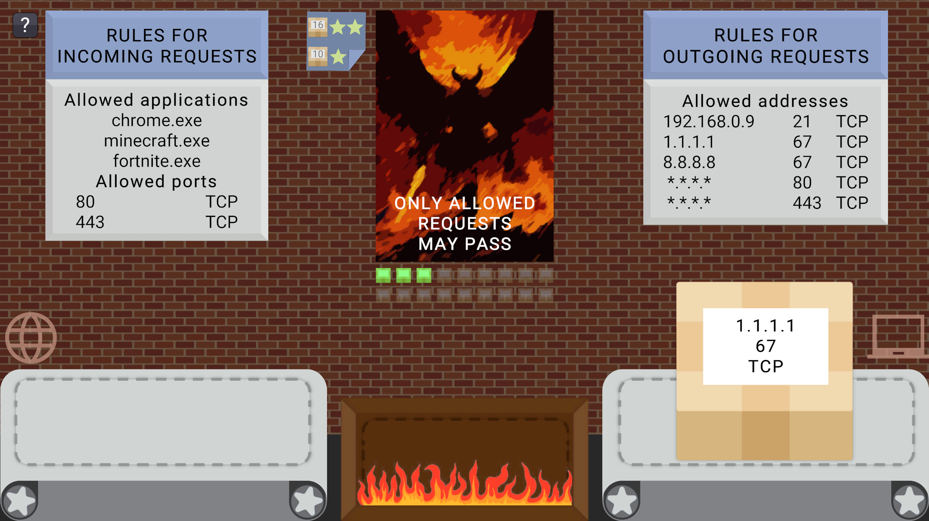
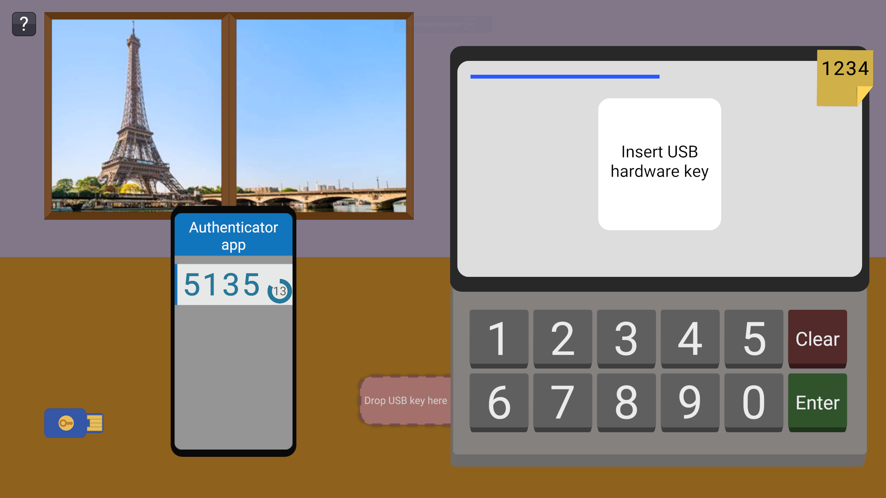
Implementation Details
Unity engine
Localization
Text rendering optimizations
Bundle size optimizations
Level-specific mechanic
Images from the thesis

Slide 11
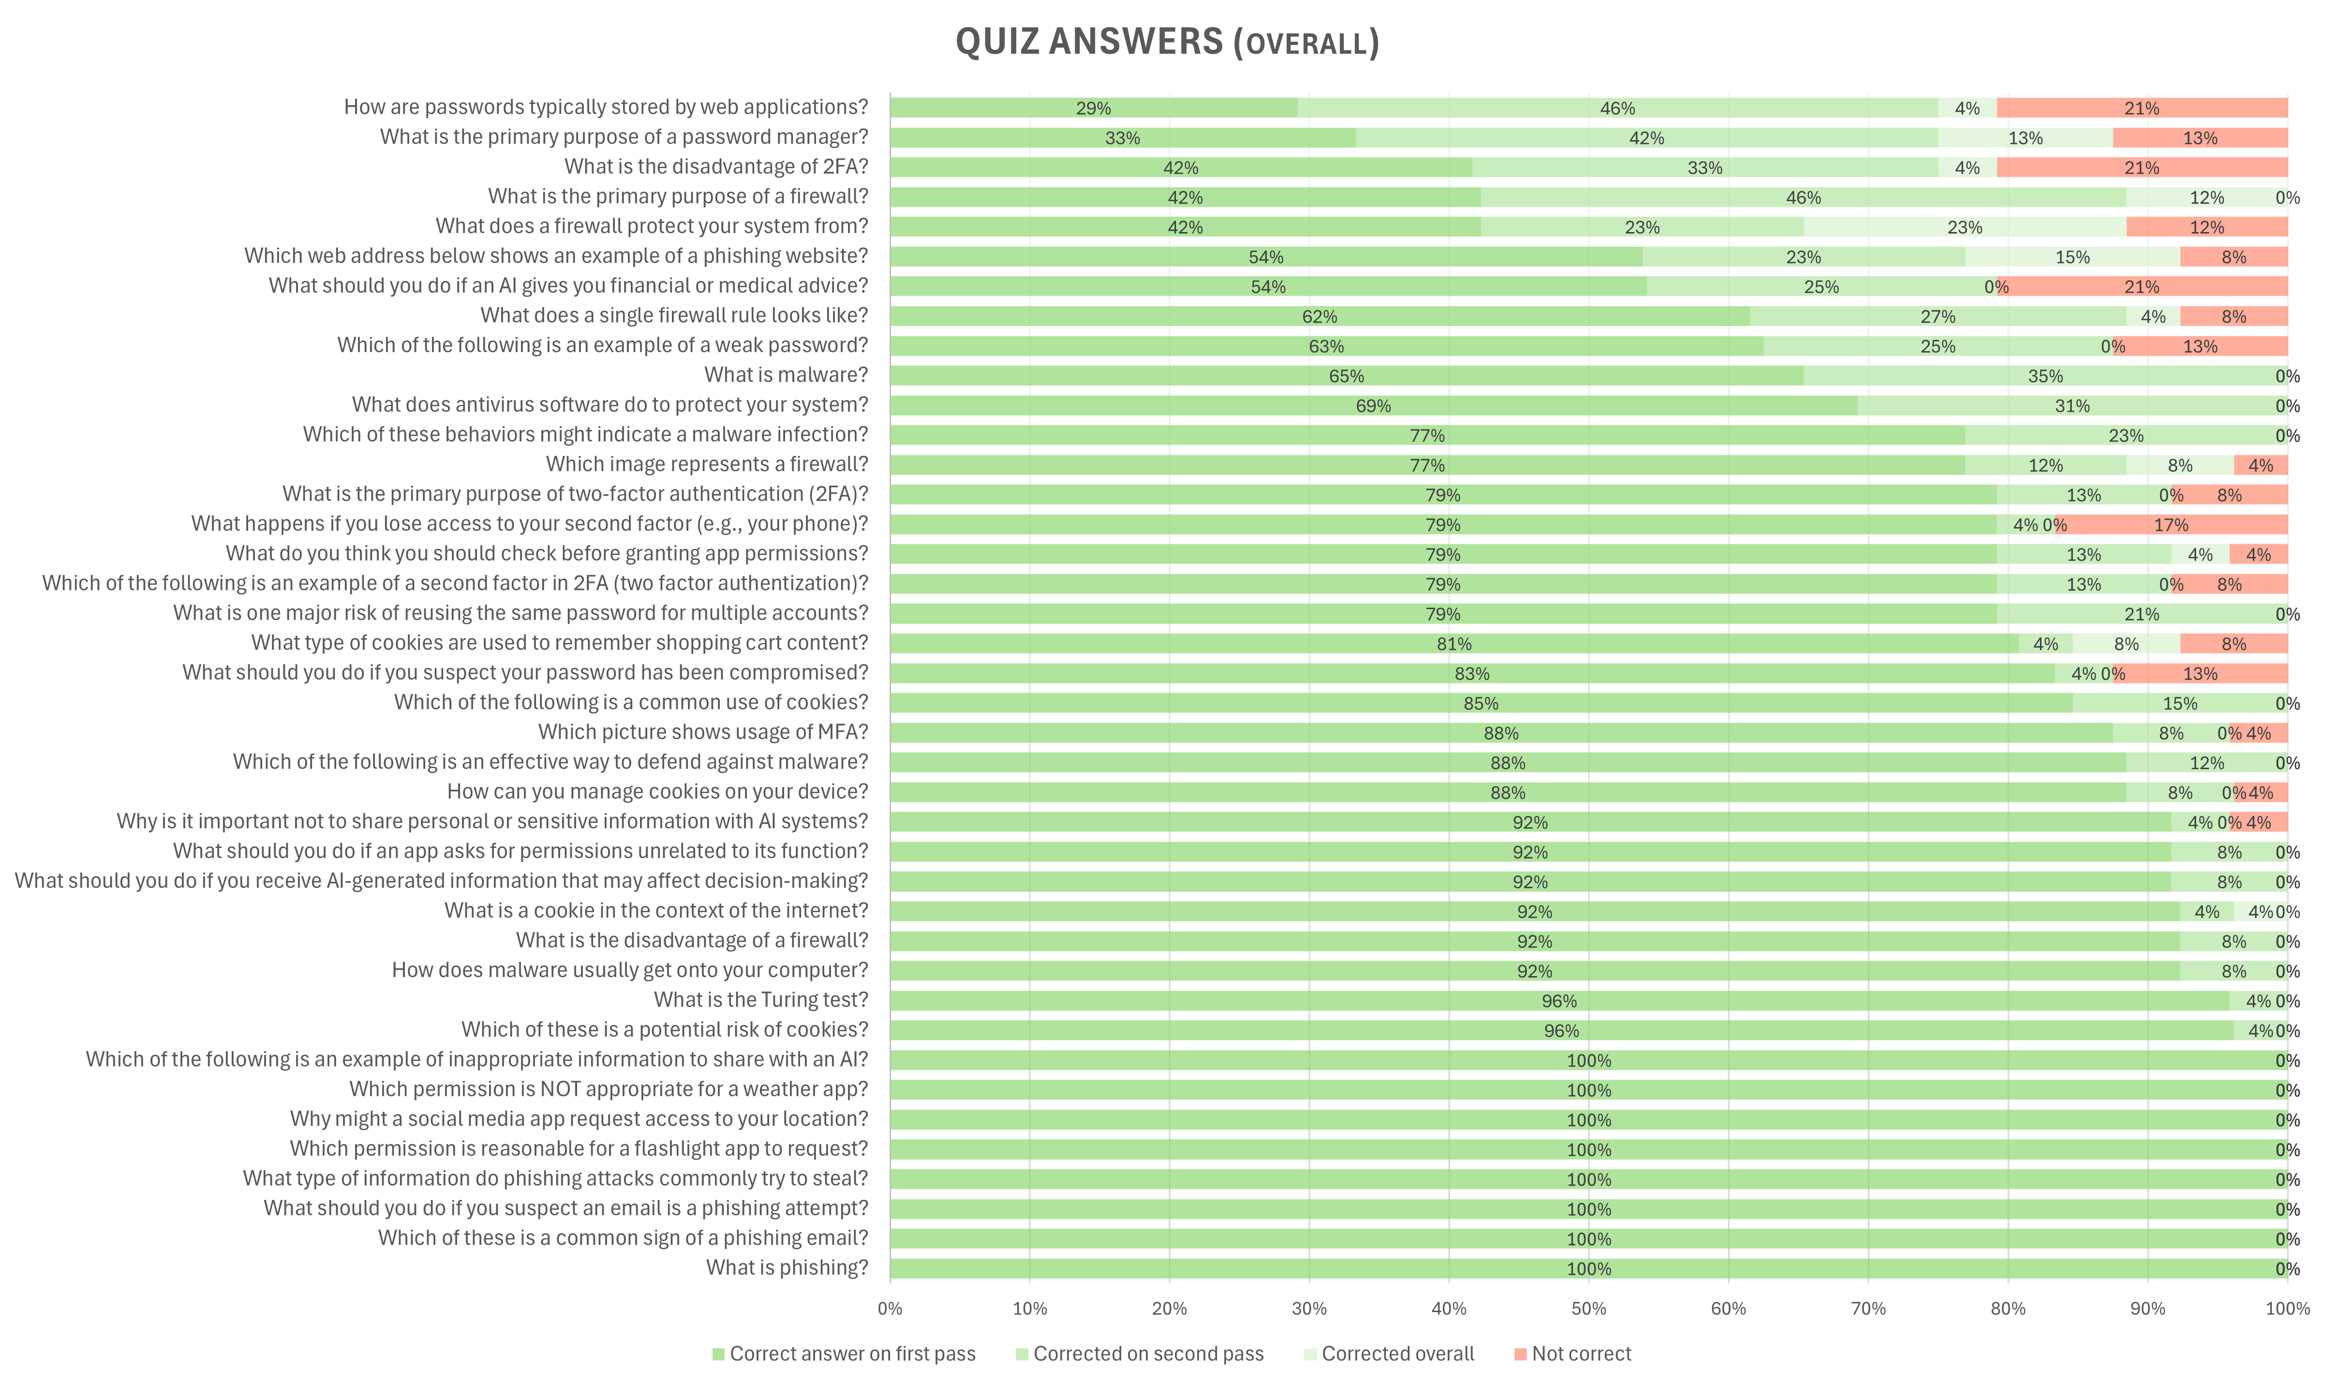
Testing & Results
School testing methodologyData collected: game logs, quiz resultsKey findings: improved knowledge, engagement metricsBug fixes and iterative improvements
Kids improved from 79.1% to 95.3% in the quiz.
Data from the thesis

Slide 12
Conclusion & Future Work
Summary of contributions: game design, implementation, evaluationEffectiveness as educational toolFuture directions: additional levels, broader localization, web analytics
Kids doesn’t have much security awareness and they are often exposed to cyber danger
Image from freedomfone.org

Slide 13

Thank You
Slide Chef presentation template
All non-CC sources are listed here: https://github.com/EbrithilNogare/TheSecurityGuideToTheInternet/wiki/Sources

